Slide 1

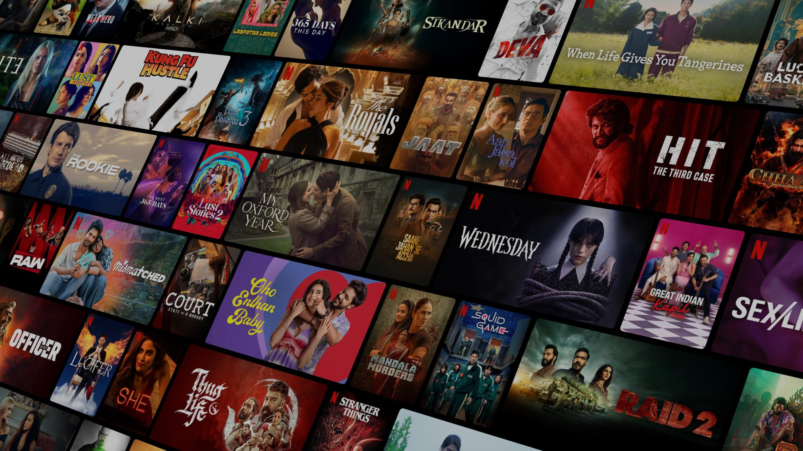

NETFLIX Data
SQL Analysis
SUBTITLE HERE

Slide 2
Project Overview
SQL-based analysis of Netflix dataset
Focus on Movies, TV Shows, Genres, Ratings, Countries, Actors
01
02
03
04
Answered 15 real-world business questions
Useful for streaming platforms, analysts & strategists

Slide 3
Dataset Used
1
3
show_id, type, title, director, casts
rating, duration, listed_in, description
Table Name: netflix
Key Columns:
2
4
0
country, date_added, release_year
Source: Single Excel dataset → imported into PostgreSQL
01
02
03

Slide 4
Project Objectives
Compare Movies vs TV Shows count
Identify top actors & directors
Study ratings & audience segmentation
Analyze country-wise distribution
Track yearly release trends (India focus)
Detect violent/sensitive content patterns

Slide 5



Business Problems Addressed (Part 1)
2025
2025
2025
2025
2025
How many Movies vs TV Shows exist?
What’s the most common rating?
Which year had the highest releases?
Top 5 countries producing Netflix content?
Which are the longest movies?

Slide 6

Business Problems Addressed (Part 2)
Content added in last 5 years
Which directors have the most shows?
TV shows with more than 5 seasons
Which genres dominate Netflix?
Netflix content from India (trends by year)
Actor insights (Salman Khan + Top 10 Indian actors)
Content flagged as Good vs Bad (violence)
01
02
NETFLIX
03
04

Slide 7
Methodology
Steps followed:
1
Data Preparation – Import Excel → PostgreSQL, assign data types
2
Basic Exploration – SELECT, DISTINCT, WHERE
3
Advanced Analysis – Aggregations, Date filters, Text search
4
Array Handling – UNNEST, STRING_TO_ARRAY for actors/genres

Slide 8
Key Insights
1
2
3
4
Movies dominate over TV Shows
Most common rating = TV-MA (mature audience)
Top producing countries = USA, India
Longest movie identified by runtime field
5
5
6
7
8
Recent years = steady content growth
Top Indian actors frequently featured
Salman Khan appeared in multiple movies (last 10 years)
Genres: Drama, Comedy, International Movies dominate
Categorization: Good vs Bad (Violent content detection)

Slide 9
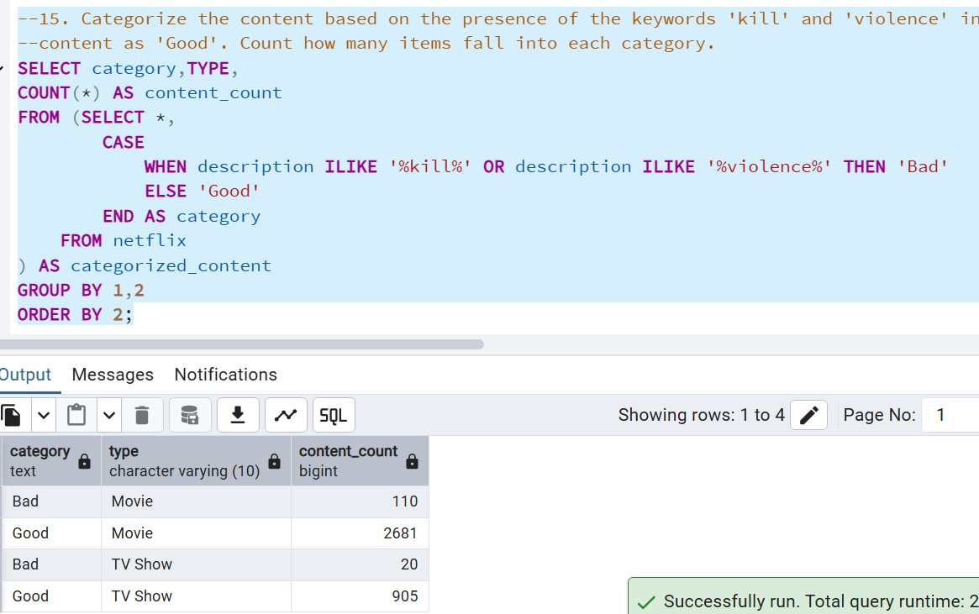
Sample Queries

Slide 10
Skills Gained
SQL wrangling with PostgreSQL
Using ILIKE, UNNEST, SPLIT_PART
Data aggregation & ranking
Querying business-focused problems
Entertainment trend analysis

Slide 11

Why This Project Matters
02
Can extend to Power BI/Tableau dashboards
01
Simulates real streaming analytics
03
Perfect for GitHub/LinkedIn portfolio
03
Proof of SQL skills on real dataset
03
Strong interview
showcase project

Slide 12
Conclusion
Analyzed Netflix dataset with 15+ SQL queries
S
W
Movies vs TV Shows
Actors & Directors
O
T
Countries & Genres
Ratings & Trends
Sensitive content categorization

Slide 13
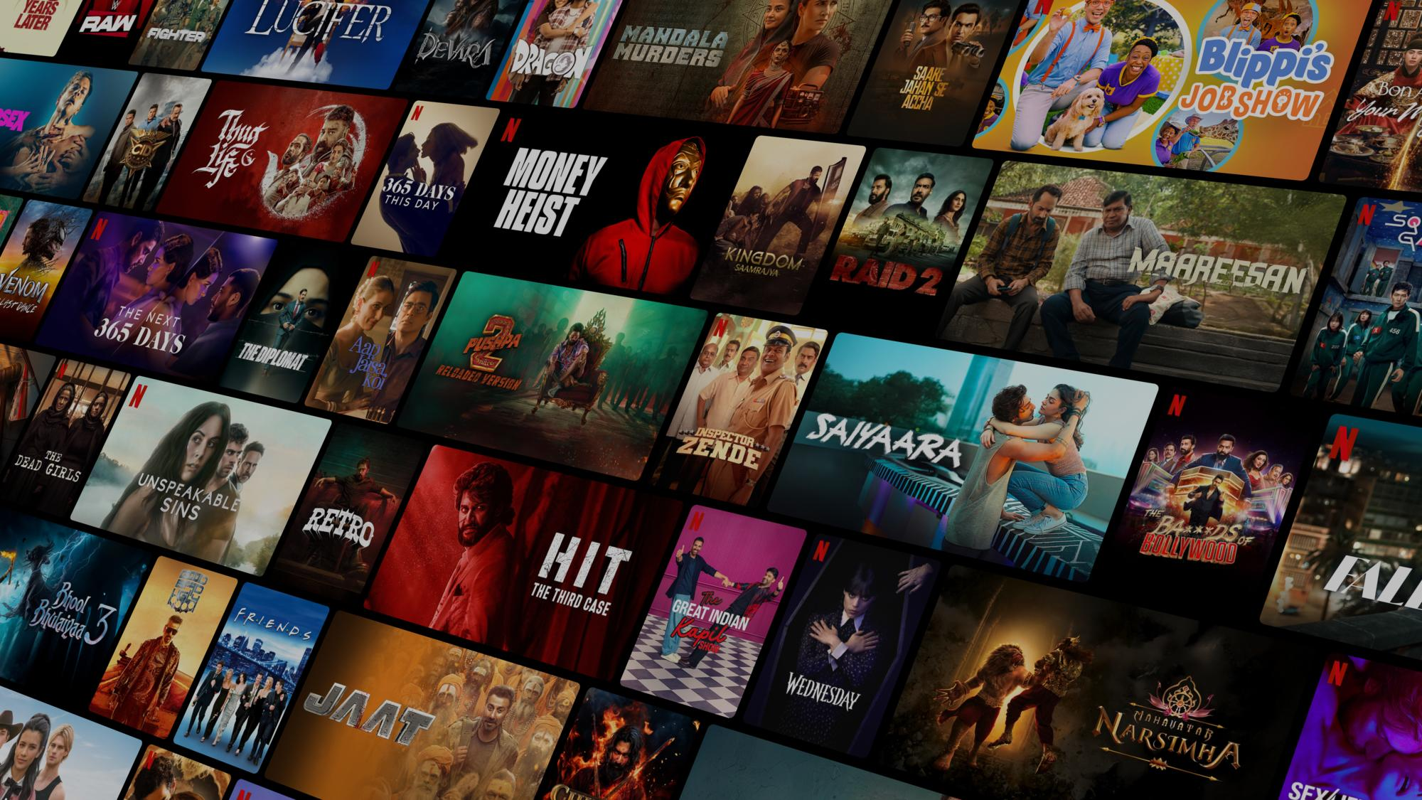
Thank You!
Every great presentation is complete with a great audience
— and that’s you!

